Slide 1
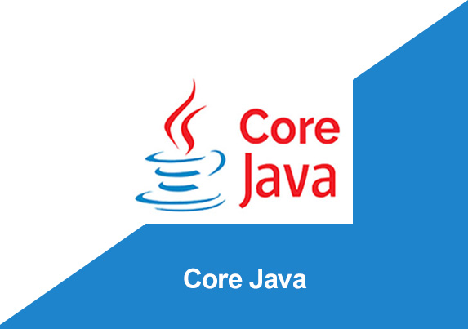
By: Manas Tuwani

Slide 2
JAVA
JAVA is Object Oriented Programming Language which has developed by “SUN MICROSYSTEMS” & later on it was acquired by Oracle. JAVA is the secured and “platform independent” language which is using to develop the online applications, secured applications, online games etc.

Slide 3
Application Of Java
According to Sun, 13 billion devices run Java. There are many devices where Java is currently used. Some of them are as follows:
Desktop Applications such as acrobat reader, media player, antivirus, etc.
Web Applications such as irctc.co.in, javatpoint.com, etc.
Enterprise Applications such as banking applications.
Mobile
Embedded System
Smart Card
Robotics
Games, etc.

Slide 4
Java Version History
JDK Alpha and Beta (1995)
JDK 1.0 (23rd Jan 1996)
JDK 1.1 (19th Feb 1997)
J2SE 1.2 (8th Dec 1998)
J2SE 1.3 (8th May 2000)
J2SE 1.4 (6th Feb 2002)
J2SE 5.0 (30th Sep 2004)
Java SE 6 (11th Dec 2006)
Java SE 7 (28th July 2011)
Java SE 8 (18th Mar 2014)
Java SE 9 (21st Sep 2017)
Java SE 10 (20th Mar 2018)
Java SE 11 (September 2018)
Java SE 12 (March 2019)
Java SE 13 (September 2019)
Java SE 14 (Mar 2020)
Java SE 15 (September 2020)
Java SE 16 (Mar 2021)
Java SE 17 (September 2021)
Java SE 18 (to be released by March 2022)

Slide 5
Features of Java
Java is Platform independent
Java is Object Oriented language
Java is Simple
Java is Robust Language
Java is Secured Language
Java is Portable

Slide 6
Popular Java Editors
To write your Java programs, you will need a text editor. There are even more sophisticated IDEs available in the market. But for now, you can consider one of the following :
Notepad − On Windows machine, you can use any simple text editor like Notepad, Textpad etc.
Netbeans − A Java IDE that is open-source.
Eclipse − Eclipse is also open source and most popular IDE for Java

Slide 7
STRUCTURE OF THE JAVA PROGRAM
package packagename;
import Statements (Optional);
public class ClassName {
public static void main(String[] args)
{
Statements;
Statements;
Statements;
}
}

Slide 8
Naming Conventions in Java
Java is pure case sensitive language and strictly following the below naming conventions.
Package: package name should always start with lower case.
Example: package packone;
Package pack2 etc.
Class: Class name should start with upper case and first character of every word in a class name should be upper case.
Example: class ClassOne
Class ClassOneTwo

Slide 9
Naming Conventions in Java
Method/Function: Method/Function should starts with lower case and first character of second word onwards should be upper case.
Example: methodOne(); methodOneTwo()

Slide 10
Note:
method name, package name, class name should not contain spaces and special characters, should start with alphabets and can contains numeric.

Slide 11
OPERATORS IN JAVA
We are using operators to perform the operations in a java program. We are using 3 different
types of operators in JAVA.
Note: Without using operators we can’t write even single program in Java
1. Arithmetic Operators: We are using arithmetic operators to perform mathematical operations
like addition, subtraction, multiplication etc.
Addition, string concatenation +
Subtraction, negation -
Multiplication *
Division /
Reminder %
Equal =
Increment ++
Decrement --

Slide 12
OPERATORS IN JAVA
2. Conditional Operators: To check/verify the conditions in a java program. (Relational operators). These are giving Boolean results.
Less than <
Greater than >
Less than equal to <=
Greater equal >=
Double equal ==
Not equal !=

Slide 13
OPERATORS IN JAVA
3. Logical Operators: To perform the logical operations in a Java Program.
AND (Any 1 condition false result false) &&
OR (Any 1 condition true result true) ||
Note: Operators are mandatory in every language but the syntaxes are different from one language to another language

